Slide 1
Smart Dairy Health: IoT-Driven Real-Time Detection and Alert System for Subclinical Mastitis and Bovine Flu in Cows
Theme: IoT for Smart Livestock Health Monitoring and Disease Prevention in Dairy Farming
Category-Software/Hardware: Hardware
Team Name: THE CREATORZ
University Name: Adhiparasakthi Engineering College, Melmaruvathur

Slide 2

Proposed Solution
SMART FLU AND MASTITIS DETECTION SYSTEM
DESCRIPTION OF PROBLEM STATEMENT:
Subclinical mastitis and bovine flu reduce milk quality and farm profits.
Traditional methods are time-consuming and inaccurate.
Delayed detection increases costs and disease spread.
A real-time monitoring system is needed for timely detection and intervention.
ABOUT THE PROPOSED SOLUTION:
Sensors monitor temperature, respiratory rate, SCC, pH, and milk conductivity for mastitis detection, and for bovine flu detection, the sensor monitors the temperature and respiratory rate of the cow.
WhatsApp API sends alerts to farmers and veterinarians for immediate action.
Designed to accommodate large herds and additional health parameters.
INNOVATION AND UNIQUENESS:
IoT integration automates disease detection, removing manual inspections.
Real-time alerts enable rapid interventions.
Monitors multiple health parameters simultaneously.
Scalable and adaptable for larger herds or additional diseases.
Cost-effective, reducing economic losses through timely management.

Slide 3
CONTD…
BUSINESS MODEL:
Value Proposition:Early detection of subclinical mastitis using advanced technology to enhance animal health, boost milk yield, and lower veterinary costs.
Target Market:Dairy farms, veterinary clinics, and dairy cooperatives.
Revenue Streams: Product Sales:Smart sensors and wearable devices.
Subscriptions:Cloud-based real-time monitoring and alerts.
Consulting:Farm assessments and health management plans.
Data Insights: Selling anonymized data to research institutions.
SDG :
SDG 2: Zero Hunger - Enhances food security and nutrition by improving dairy production efficiency. SDG 3: Good Health and Well-Being - Promotes animal health for better milk quality and consumer safety.
SDG 12: Responsible Consumption and Production - Supports sustainable agriculture via precision livestock farming.
SDG 9: Industry, Innovation, and Infrastructure - Drives agricultural innovation, boosting efficiency and productivity.
MARKET OPPORTUNITY :
Dairy Industry Growth: Expanding markets drive the need for efficient livestock management.
Health Monitoring: Rising adoption of tech for real-time livestock health monitoring boosts productivity.
Regulatory Compliance: Stricter rules on milk quality and animal health increase demand for disease detection.

Slide 4
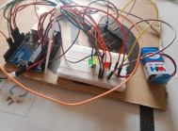

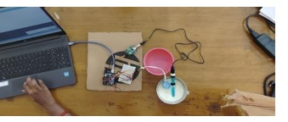
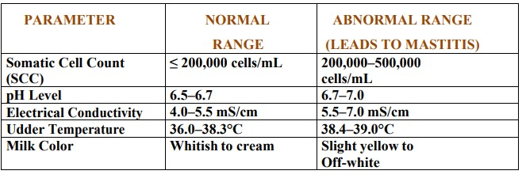
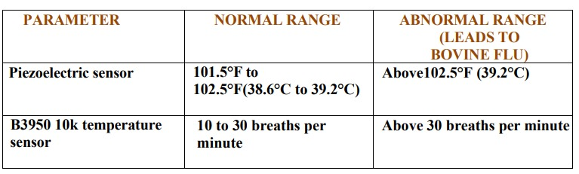
TECHNOLOGIES TO BE USED:
PROGRAMMING LANGUAGES : C(Arduino), Python(Backend), HTML, CSS, JS(Frontend)
FRAMEWORK : IOT, Arduino, ThingSpeak Cloud or Mendix Cloud
HARDWARE : SUBCLINICAL MASTITIS (DIY Conductivity Sensor, DH18B20 Sensor, Somatic Cell Count Sensor) BOVINE FLU (Temperature Sensor, Piezoelecrtic Sensor)
PARAMETER RANGE :
SUBCLINICAL MASTITIS : BOVINE FLU :

Slide 5
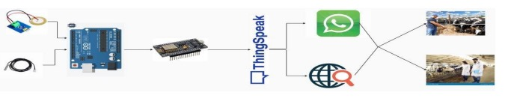
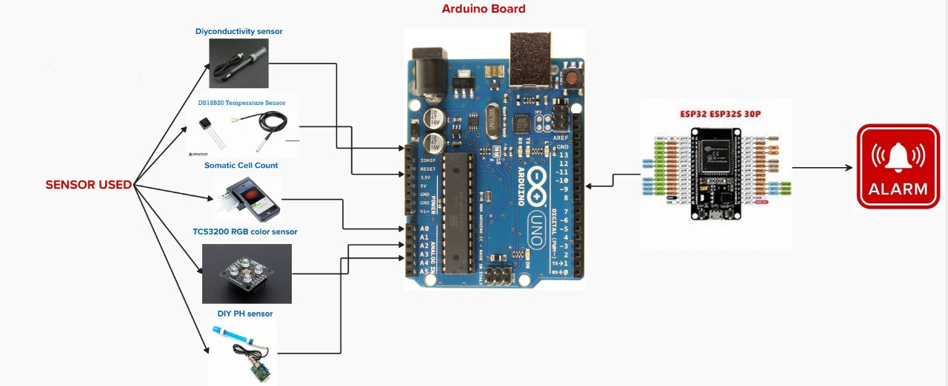
ARCHITECTURE DIAGRAM :
FOR BOVINE FLU DETECTION :
FOR SUBCLINICAL MASTITIS :

Slide 6
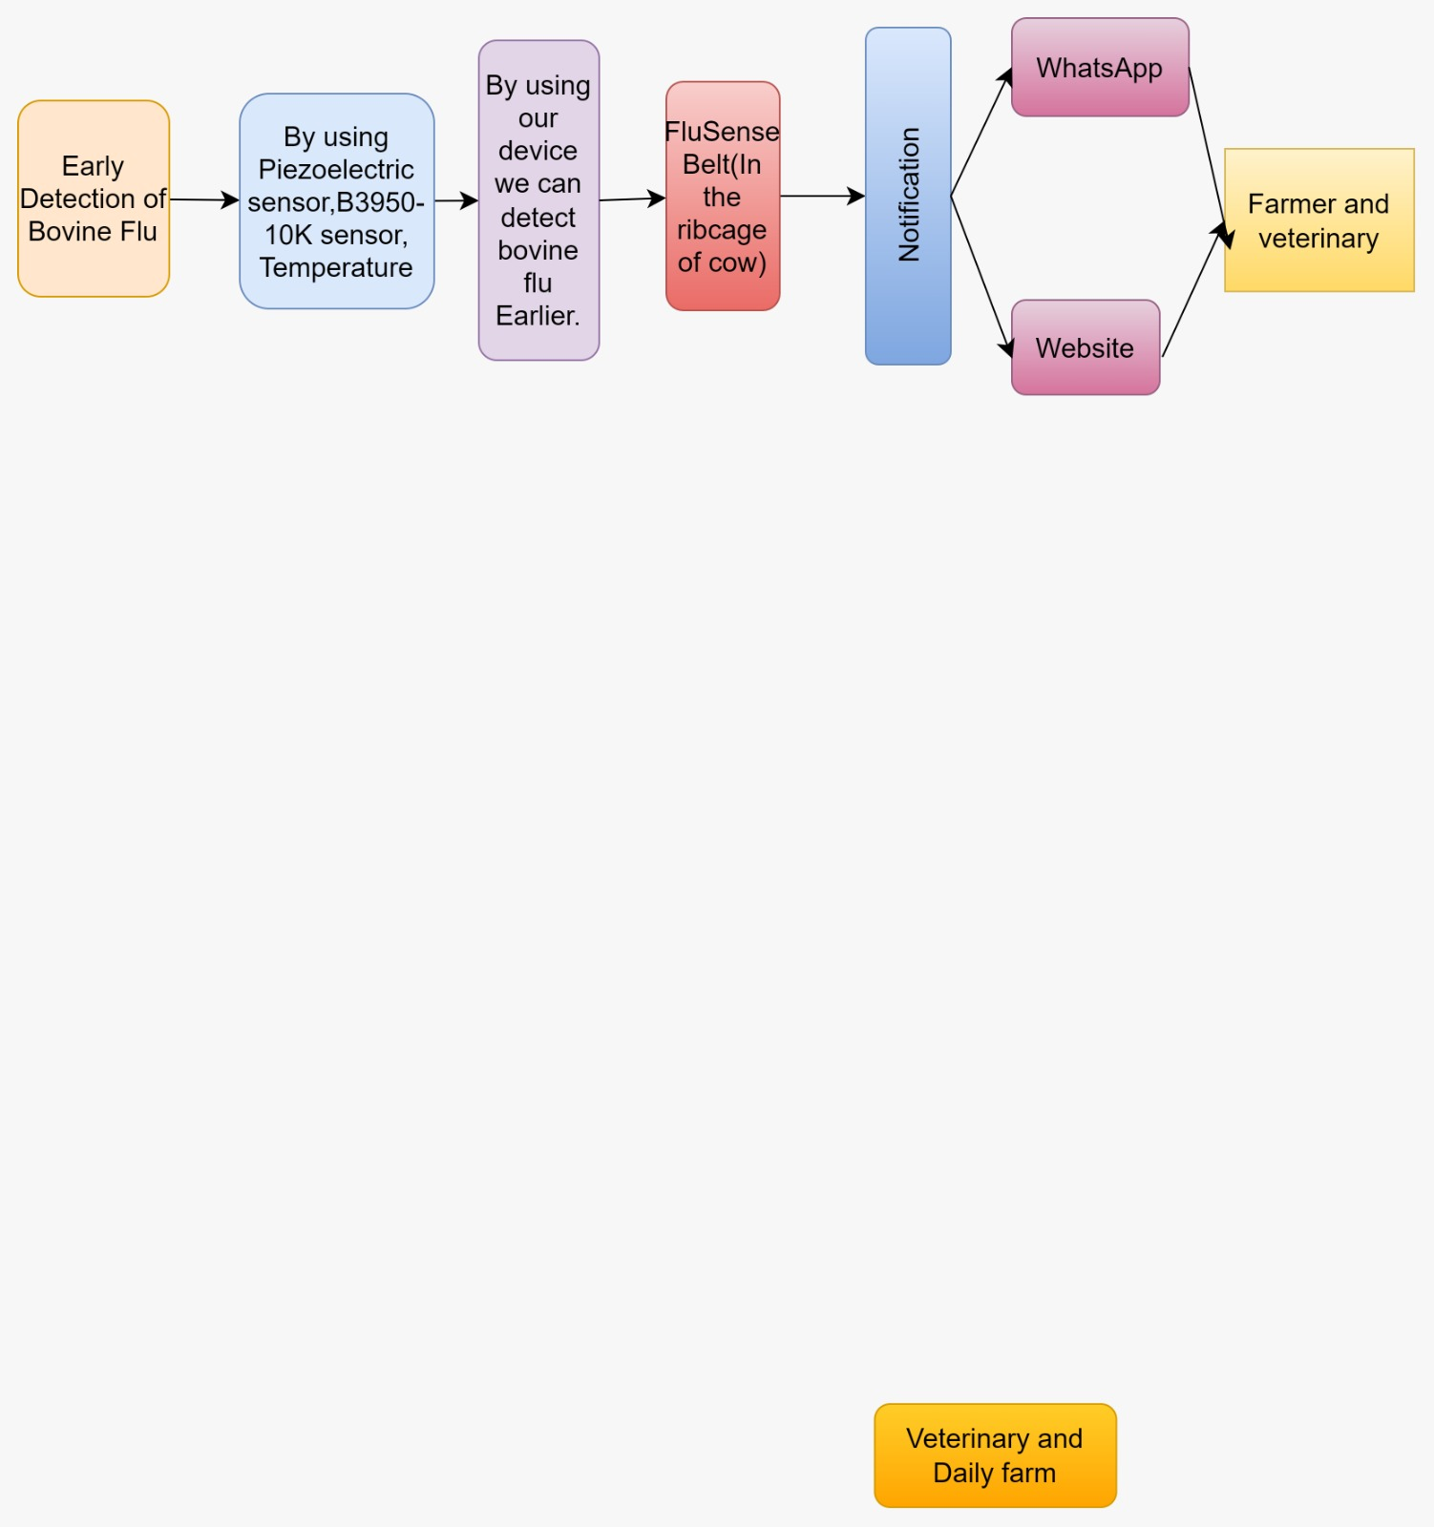
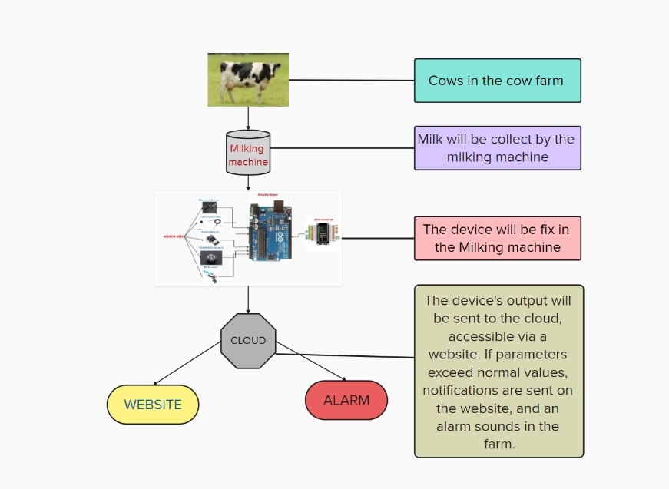
FLOWCHART :
FOR BOVINE FLU :
FOR SUBCLINICAL MASTITIS :

Slide 7




FEASIBILITY AND VIABILITY :
FEASIBILITY:
This approach has the potential to reduce economic losses associated with decreased milk production improve overall herd health.
VIABILITY :
Sensor-based system for mastitis and bovine flu detection.
The hardware is generally affordable and accessible, enhancing the system’s economic Viability.
POTENTIAL CHALLENGES AND RISKS :
The implementation of sensor-based systems for mastitis detection may face challenges such as high initial costs, complexity in data management, and potential resistance from farmers unfamiliar with new technologies.

Slide 8
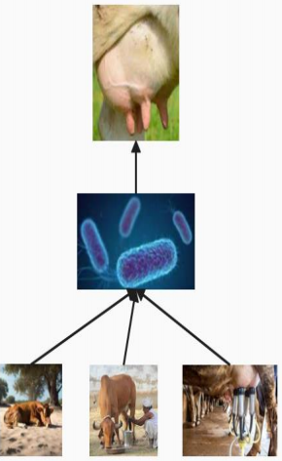


IMPACT AND BENEFITS ENVISAGED
POTENTIAL IMPACT OF TARGET AUDIENCE :
Individuals managing dairy farms who seek effective methods to ensure cattle health and optimize milk production.
They are directly responsible for monitoring their herds and implementing preventative health measures.
BENEFITS OF THE SOLLUTION :
Early detection of subclinical mastitis helps dairy farmers minimize losses by maintaining milk production and reducing treatment costs.

Slide 9
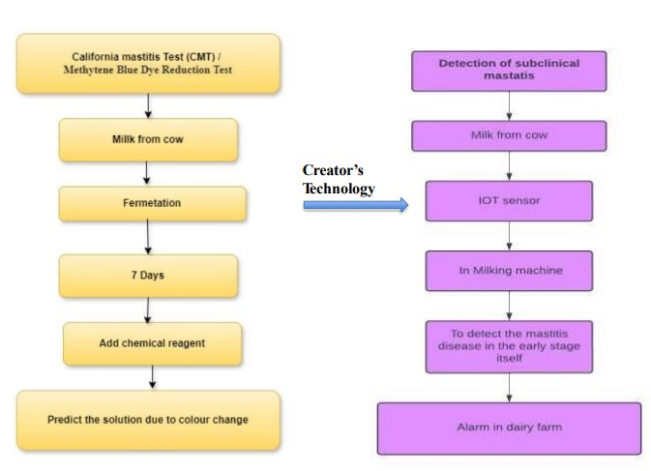
REFERENCES :
Iwasaki, W., Morita, N., & Nagata, M.P.B. (2019). IoT sensors for smart livestock management.
2. Saravanan, K., & Saraniya, S. (2017). Cloud IoT-based livestock monitoring and identification system.
3. Chaudhry, A.A., et al. (2020). IoT and ML-enabled livestock monitoring.
4. Neethirajan, S. (2017). Advances in wearable sensors for animal healthmanagement.
5. Padmavathy, T.V., et al. (2022). Embedded sensor-based cattle health monitoring system.

Slide 10
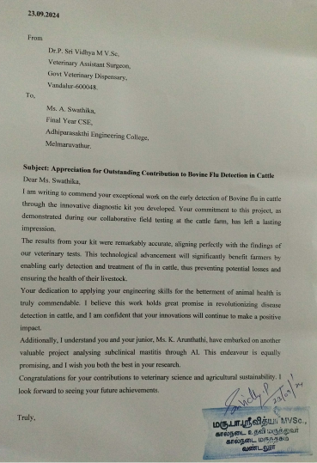
OUTPUT VIDEO LINK:
https://drive.google.com/file/d/1bT36ngDfrD9GSOrxynYtSXMfssDDb8Kc/view?usp=sharing
APPRECIATION LETTER FROM VETERINARIAN DOCTOR:

